Slide 1
The Birth of Lithuanian Talmudism from the Self-Destruction of Kabbalah
Yonatan Y. Brafman, Assistant Professor of Modern Judaism
Department of Religion, Tufts University

Slide 2
Orienting Questions
Is Halakhah (Jewish Law) a source of continuity or discontinuity in modern Judaism?
What is the relation between law and other discourses in modern Judaism?
How do ways of conceptualizing Halakhah influence the general approach of modern Jews to other areas of life?

Slide 3
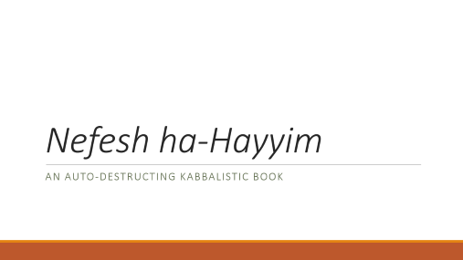
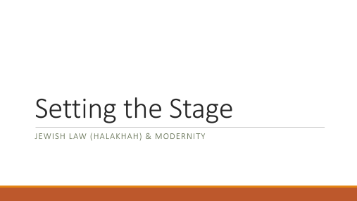
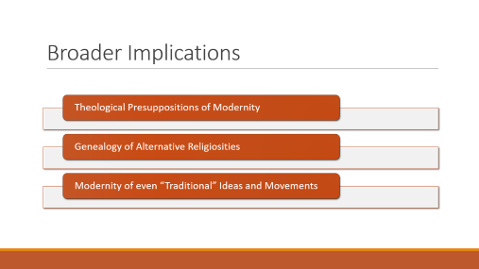
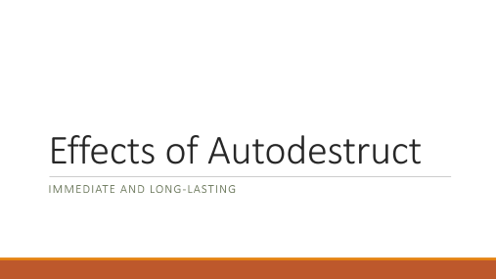
Overview

Slide 4
Setting the Stage
Jewish LAW (Halakhah) & MODERNITY

Slide 5
Jewish Law and the Discourse of Modernity
“It was thus not beliefs or opinions that determined the identity of Judaism. Its continuity was that of religious praxis.” (Yeshayhu Leibowitz)
“Halakhah has a fixed a priori relationship to the whole of reality…. As we said above, [halakhic man’s] world view is similar to that of the mathematician: a priori and ideal.” (Joseph Soloveitchik)
Continuity and Rationality

Slide 6
Theology and Modernity (Taylor)
Subtractive Account
Secularism and the Recession of Theology
Substantive Account
Theological Presupposition of Secularity

Slide 7
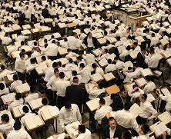
The Yeshiva Movement
19th Century Eastern European Origin
Ideal of (Male) Talmud Study
  Broad-Based
  Indefinite
  Theoretical
Establishment of the Institutionalized and Residential House of Study
  Beth Medrash Govoha in Lakewood, New Jersey (est. 1943); 6,715 students
  Mir Yeshiva in Jerusalem (est. 1944); 9,000 students

Slide 8
Nefesh ha-Hayyim
An Auto-destructing Kabbalistic Book

Slide 9
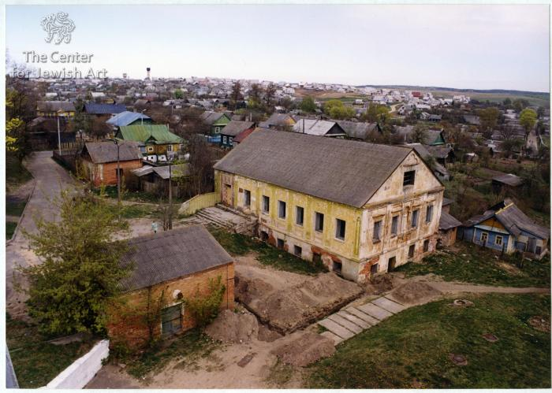
Hayyim of Volozhin, His Institution, and Book
Hayyim of Volozhin
1749-1821
Teacher and Author
Opponent of Hasidism
Etz Hayyim Yeshiva
1795-1892
Institutionalized and Residential
Hotbed of Eastern Jewish Enlightenment
Debate about Closure
Nefesh ha-Hayyim (Soul of Life)
Published posthumously in 1821
Theology for an Anti-Theological Movement
Underwrites Ideal and Institution
Lita: Polish-Lithuanian Commonwealth/Russian Empire/Belarus
Student of Elijah (the Genius) of Vilna

Slide 10

Autodestruct Books
Autodestruct Books: Engage in a particular discourse, intellectual framework, or mode of argumentation with the aim of superseding it.
Wittgenstein: “My propositions are elucidatory in this way: he who understands me finally recognizes them as senseless, when has climbed out through them, on them, over them. (He must so to speak throw away the ladder, after he has climbed upon on it.).” (Wittgenstein, Tractatus Logico-Philosophicus)
  From Rationalism to Mysticism
Hayyim of Volozhin
  From Kabbalistic Mysticism to Legal Rationalism
  From Esotericism to Exotericism

Slide 11
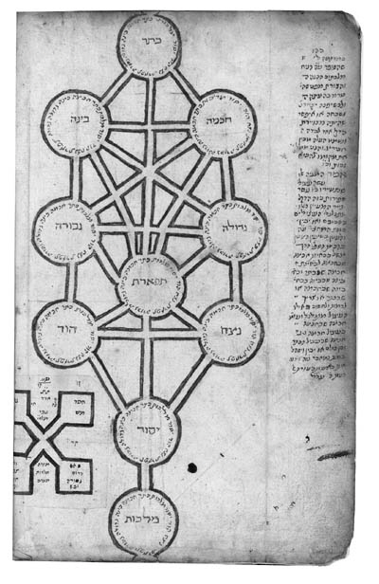
Background: Kabbalah
Jewish “Mysticism” or Theosophy (Divine Wisdom)
Biblical Texts
  “The Work of Creation” in Genesis
  “Moses’s Vision” in Exodus
  “The Vision of the Chariot” in Ezekiel
Books of the Palaces of the Chariots
Zohar, 13th century
Isaac Luria, 1534-1572
Israel Sarug, 16th century

Slide 12
Background: Lurianic Cosmology
Eyn Sof: In-finite
  Contraction (Tzimtzum), Line (Kav), and Shattering (Shevira)
‘Olamot: Levels of Being
  Atzilut: Emanation
  Bari’ah: Creation
  Yetzirah: Formation
  ‘Asiyah: Action
Sefirot: Fractal Expression of God
  Keter: Crown
  Hokhmah: Wisdom
  Binah: Understanding
  Hesed: Kindness
  Gevurah: Strength
  Tiferet: Glory
  Netzah: Victory
  Hod: Splendor
  Yesod: Foundation
  Malkhut: Kingship
Tikkun: Rectification through Theurgic Performance of Commandments

Slide 13
Nefesh ha-Hayyim
Goals
Combat Perceived Threat of Pantheism and Antinomianism
Hasidism and “Cleaving” to God
Support Observance of Commandments and Study of Torah
Structure
Kabbalistic Cosmology and Anthropology
Prayer as Mediating Relation between God and Universe
Divine “Contraction” as Response to Pantheism and Antinomianism
The Unique Cosmogonical Role of the Torah

Slide 14
Kabbalistic Cosmology and Anthropology
“This is the meaning of ‘God created man in his image. In the of image of God (Elohim) He created him’ (Gen. 1: 27) … that just as God is the Elohim—the one who empowers All existence in all of the worlds, arranging and controlling them all each moment as per His Will, similarly God willed it that man is enabled to exert controls such that he is the one who opens and closes a myriad of powers and worlds according to the details of his behavior in all that he does at each and every movement corresponding to the supernal source of his actions, speech, and thoughts, as if man were also the source of their power, as it were.” (I: 3)
“The key principle is that God, after he created all of the worlds, created the human being last in the sequence of Creation, a wonderous creature, a power which ‘gathers in from all of the camps,’ with all the supernal wonderous subtle shining lights, worlds, and chambers which preceded him being incorporated within him and the entire supernal glorious structure of the arrangements of the components of the Divine Chariot and all the specific powers found in all the supernal and lower worlds, they all contribute power and part of their essence to his construction and are all incorporated within him among the many detailed powers within him…. [A]ll his deeds impact to arouse his source in the supernal realms just as when one shakes a cord at its lower end it sends a wave up the cord which also shakes its upper end.” (I: 6)
Human as the “Image of God” (Tzelem Elohim)

Slide 15
Divine Contraction
God’s Acosmic Perspective vs. Human Theistic Perspective
“Now all the principles of the Torah, including all the positive and negative commandments follow this [human perspective alone]. As it is certainly [and only] from our perspective that differentiation exists between places…. Similarly for the entire framework of obligation which we are commanded to do by [God’s] mouth as set out in his holy Torah….This even though, in truth, from God’s perspective where he perceives his essence, He is equally distributed filling all without any separation and without any differentiation or change in any place at all, all being a pure Absolute Unity [and unchanged], literally as before Creation. Nevertheless, we are unable and not permitted to intellectually engage in this awesome concept at all—[to attempt] to fathom how the Unified Master fills All, and all places in a sublimely unified and completely equal way” (III: 6)
Response to Pantheism and Antinomianism

Slide 16
The Role of the Torah and its Study
Study of Torah for its Own Sake
  “During one’s preoccupation and study of the Torah, certainly there is no need at all for the matter of [contemplative] cleaving [to God], for the preoccupation and study itself is cleaving to the Blessed One’s Will and Word, and the Blessed One, his Will, and his Word are Identical.” (IV: 10)
Torah as Projection of Infinite into Profane World
  “And [the Torah] also has an additional measure of awesome holiness as compared to the levels of being, because…when they unfold downward and descend…they become so much coarser, and they are reduced in holiness and light…until in this world they become so profane that we can relate to them with profane behavior. However, the holy Torah, even though it also flowed downward and descended from the supernal root of its source in the holy…even so its initial holiness remains the same also in this world….” (IV: 27)

Slide 17
The Hidden Garment
Root of the Torah
  “The supernal root of the holy Torah is the highest called the worlds of the infinite, the secret of the hidden garment (malbush), which is intimated in the wise, wonderous secrets of the teachings of our master Isaac Luria.” (IV: 10)
Original, Divine Autoeroticism
  “When the Holy Blessed One was delighting in Himself, that is, He was rejoicing and delighting, and just as it is, as it were, with a human so too with the Holy Blessed One, out of the joy…there is a spark, and of the motion, due to the spark, the Torah is created.” (Sarug, Limmudei ha-Atzilut, 3a)
Torah as both Projection of Infinite into Profane World and Blueprint for that World

Slide 18
Holy Torah, Profane World
“[I]t is only in those moments when one is held fast in the love of the Torah, and is preoccupied with and contemplates it fixedly, that he is living the highest true life, connected and attached to, as it were, the Eternally Living Blessed One, for the Holy Blessed One and the Torah are one. And if, God forbid, he should abandon his learning and separate from a constancy of involvement with it, involving himself with the world’s vanities and pleasures, he is disassociated and cut off from the highest true life and drowns himself in the waters of sin.” (IV: 33)

Slide 19
Effects of Autodestruct
Immediate and Long-Lasting

Slide 20
Esoteric Theosophy → Exoteric Law
Disconnect between
Law and Kabbalah/Theosophy
Commandments and Reasons
God’s World and World
Inversion of Conventional Relation

Slide 21
Further Effects
Constitution of the Halakhah (Jewish Law) as Discrete Object of Study and Practice
Constructed Continuity
Faith-Based Rationality
Circumscription of Judaism as Jewish Law
Jewish Participation in Modern World
Science and Technology
Politics and Economics
Preservation and Privatization

Slide 22
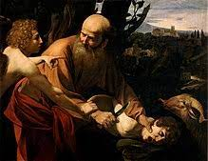
Consequences for Modern Judaism
Sophisticated Legal Positivism
Gnosticism
“Akedah” Theology (Irshai)

Slide 23
Broader Implications
Theological Presuppositions of Modernity
Genealogy of Alternative Religiosities
Modernity of even “Traditional” Ideas and Movements

